Slide 1

Course Title : Database System Sessional
Course Code : CCE - 224
Lab Problem : 02
Submitted To
Professor Dr. Md. Samsuzzaman
Department of Computer and Communication Engineering
Faculty Of Computer Science & Engineering.
Submitted By
Name :
Md Mohidul Alam
Id :
1902016
Reg. No :
08722
Session :
2019 - 20
Patuakhali Science & Technology University
Dumki, Patuakhali - 8602

Slide 2
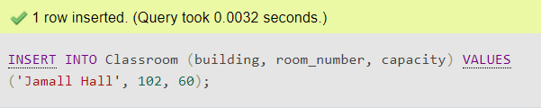
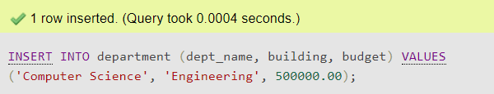
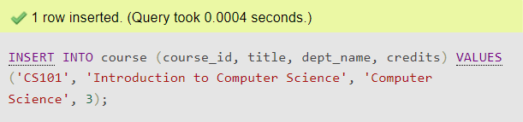
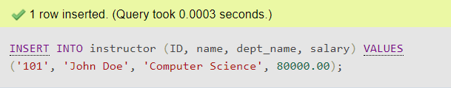
Insert into Classroom Table
INSERT INTO Classroom (building, room_number, capacity) VALUES (Jamall Hall', 102, 60);
Insert into department Table
INSERT INTO department (dept_name, building, budget) VALUES ('Computer Science', 'Engineering', 500000.00);
Insert into course Table
INSERT INTO course (course_id, title, dept_name, credits) VALUES ('CS101', 'Introduction to Computer Science', 'Computer Science', 3);
Insert into instructor Table
INSERT INTO instructor (ID, name, dept_name, salary) VALUES ('101', 'John Doe', 'Computer Science', 80000.00);

Slide 3
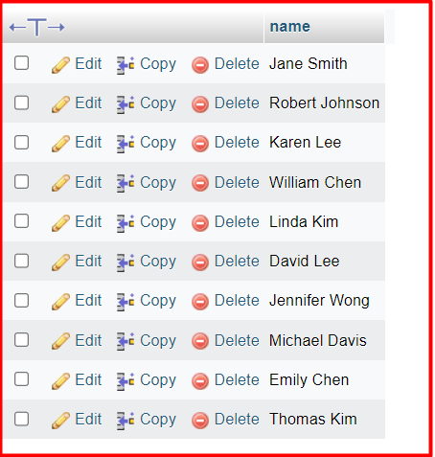
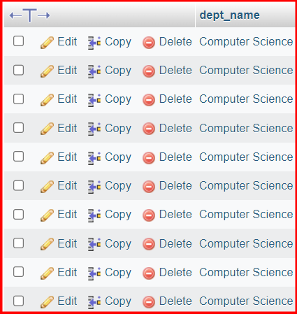
select name from instructor;
SELECT dept_name FROM instructor;

Slide 4
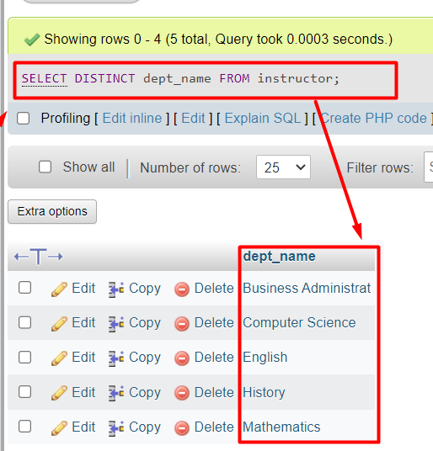
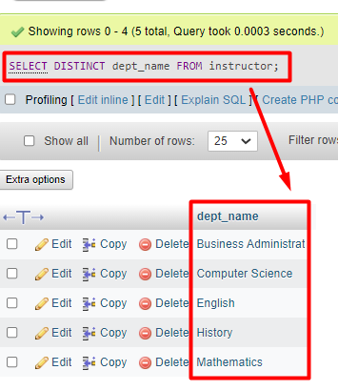
SELECT DISTINCT dept_name FROM instructor;
SELECT DISTINCT dept_name FROM instructor;

Slide 5
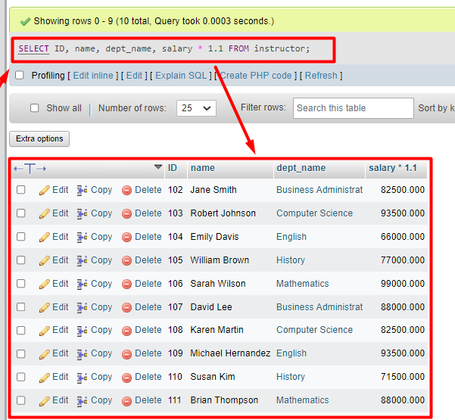
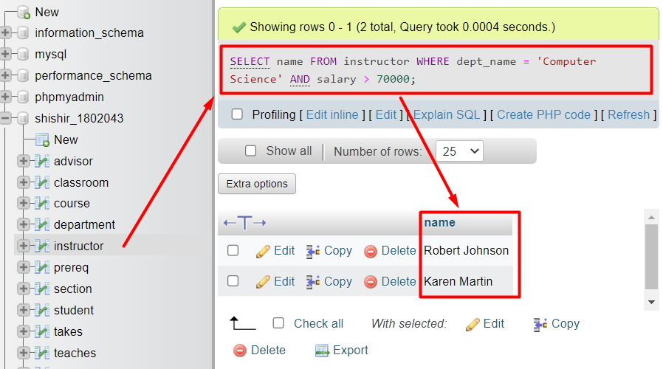
SELECT ID, name, dept_name, salary * 1.1 FROM instructor;
SELECT name FROM instructor WHERE dept_name = 'Computer Science' AND salary > 70000;

Slide 6
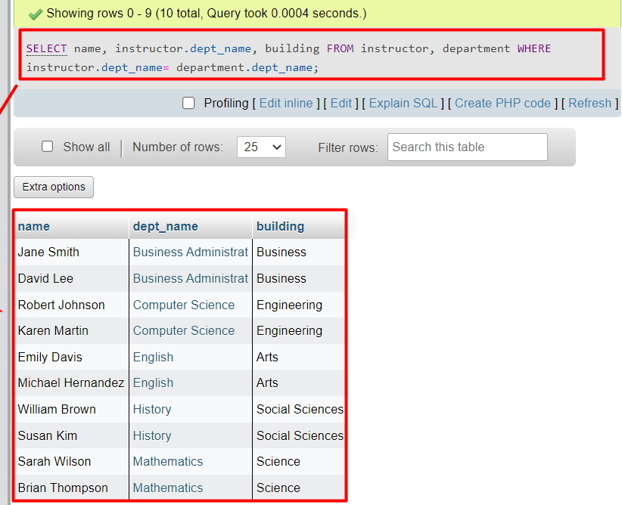
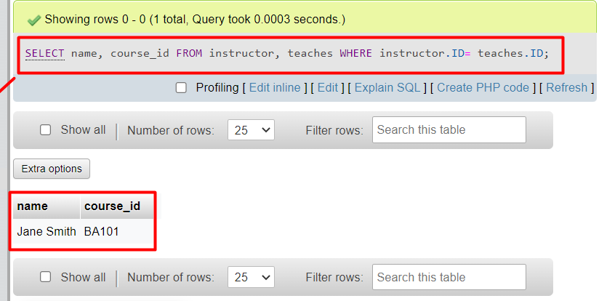
SELECT name, instructor.dept_name, building FROM instructor, department WHERE instructor.dept_name= department.dept_name;
SELECT name, course_id FROM instructor, teaches WHERE instructor.ID= teaches.ID;

Slide 7
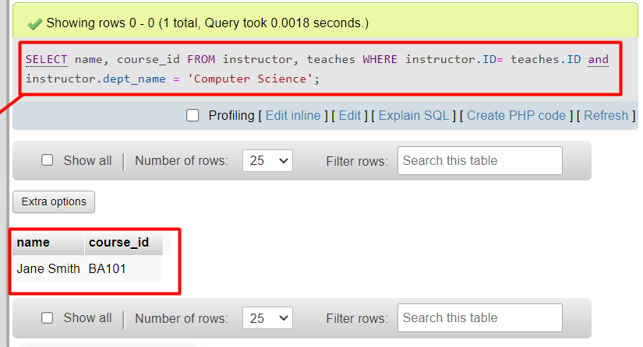
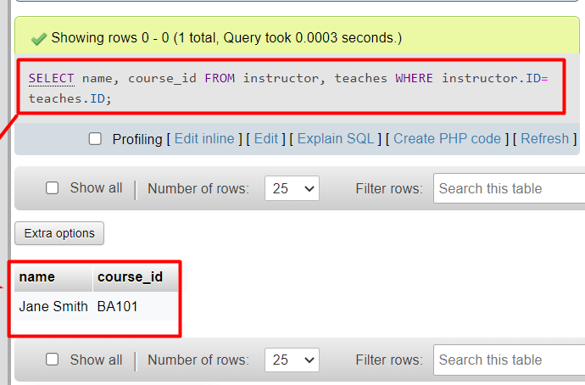
SELECT name, course_id FROM instructor, teaches WHERE instructor.ID= teaches.ID and instructor.dept_name = 'Computer Science';
SELECT name, course_id FROM instructor, teaches WHERE instructor.ID= teaches.ID;

Slide 8
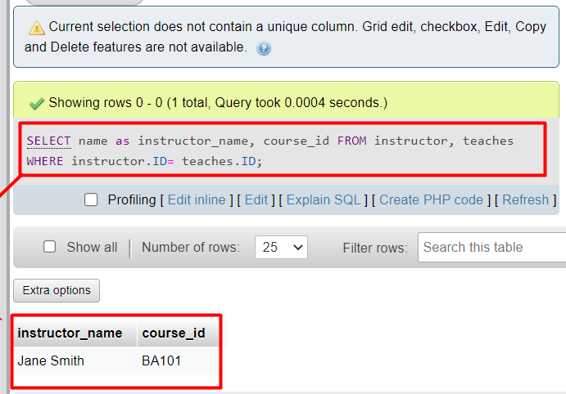
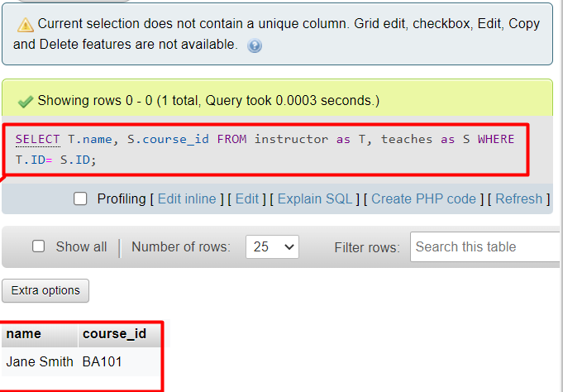
SELECT name as instructor_name, course_id FROM instructor, teaches WHERE instructor.ID= teaches.ID;
SELECT T.name, S.course_id FROM instructor as T, teaches as S WHERE T.ID= S.ID;

Slide 9
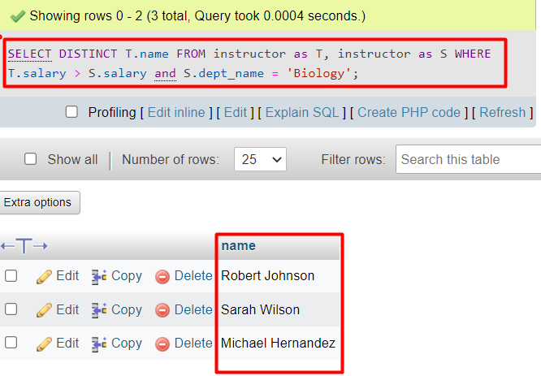
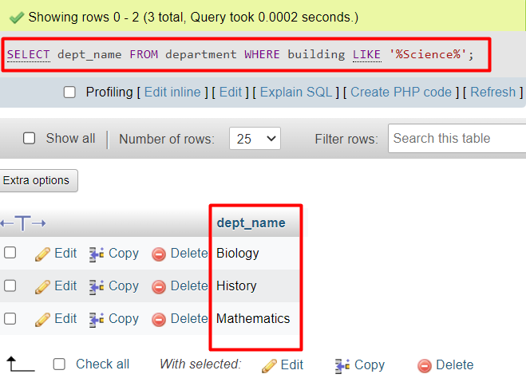
SELECT DISTINCT T.name FROM instructor as T, instructor as S WHERE T.salary > S.salary and S.dept_name = 'Biology';
SELECT dept_name FROM department WHERE building LIKE '%Science%';

Slide 10
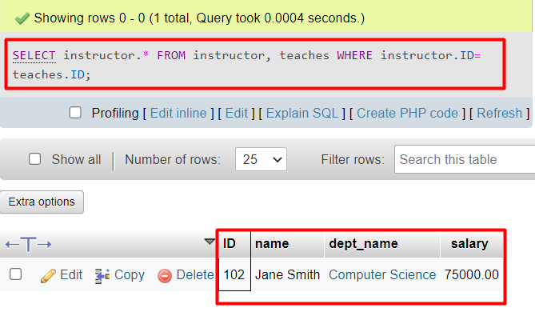
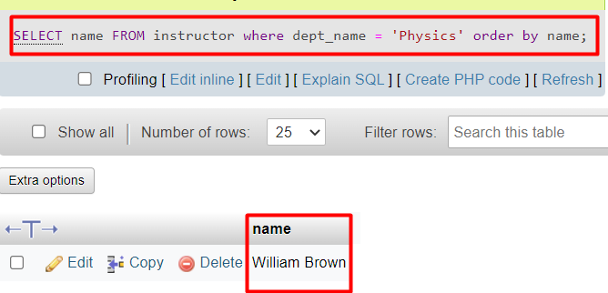
SELECT instructor.* FROM instructor, teaches WHERE instructor.ID= teaches.ID;
SELECT name FROM instructor where dept_name = 'Physics' order by name;

Slide 11
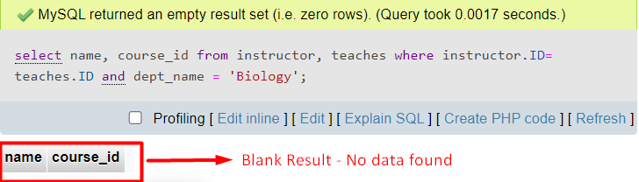
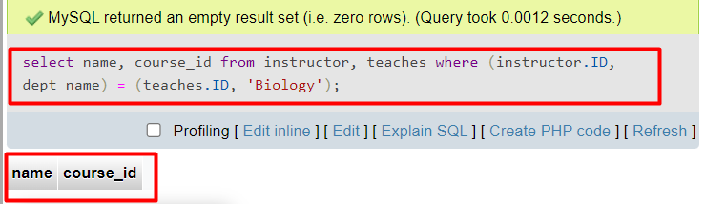
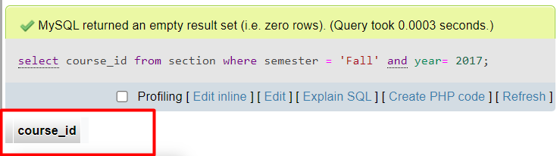
select name, course id from instructor, teaches where instructor.ID= teaches.ID and dept name = 'Biology';
select name, course_id from instructor, teaches where (instructor.ID, dept_name) = (teaches.ID, 'Biology');
select course_id from section where semester = 'Fall' and year= 2017;

Slide 12
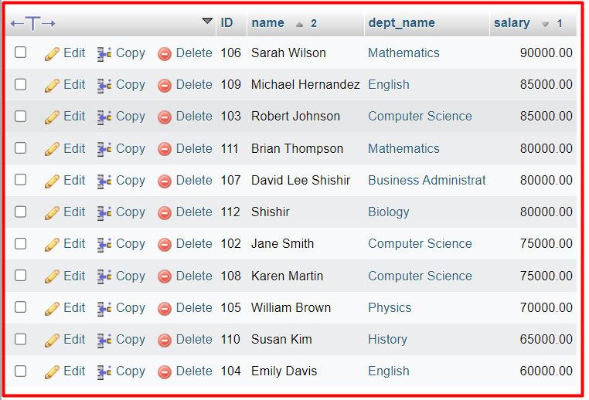


SELECT * FROM instructor ORDER BY salary DESC, name ASC;
select name from instructor where salary between 90000 and 100000;
SELECT name FROM instructor WHERE salary <= 100000 AND salary >= 90000;

Slide 13
select name, course id from instructor, teaches where instructor.ID= teaches.ID and dept name = 'Biology';
select name, course_id from instructor, teaches where (instructor.ID, dept_name) = (teaches.ID, 'Biology');
select course_id from section where semester = 'Fall' and year= 2017;

Slide 14
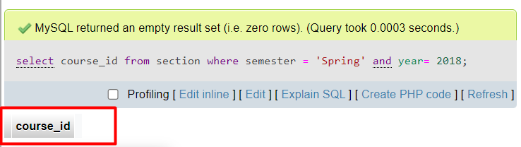
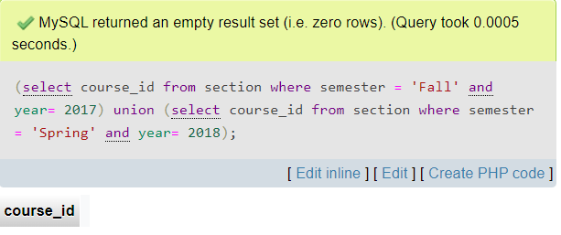
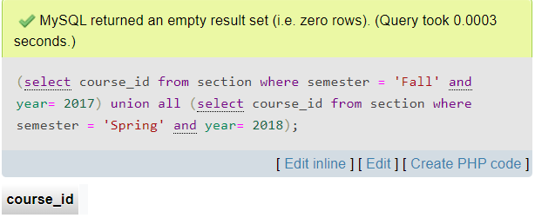
select course_id from section where semester = 'Spring' and year= 2018;
(select course_id from section where semester = 'Fall' and year= 2017) union (select course_id from section where semester = 'Spring' and year= 2018);
(select course_id from section where semester = 'Fall' and year= 2017) union all (select course_id from section where semester = 'Spring' and year= 2018);

Slide 15
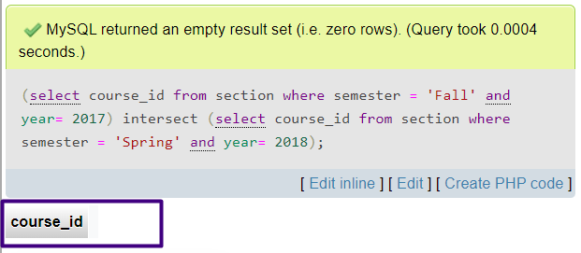
(select course_id from section where semester = 'Fall' and year= 2017) intersect (select course_id from section where semester = 'Spring' and year= 2018);

